Slide 1
WELCOME!!
Ella Baker Elementary Art Docent Program 2023-24

Slide 2
Thank you for volunteering!
Art Docent Leads: Meghan, Salma & Tayyaba
artdocent@ellabakerptsa.org

Slide 3
Logistics
Please sign in!
Make sure you are an approved volunteer in the Lake Washington School District (LWSD)
https://www.lwsd.org/get-involved/volunteering-in-lwsd/volunteer-application-process
All resources available at Enrichment Art Docent (ellabakerptsa.org)

Slide 4
Goals Today
Introductions: Meet your fellow class art docents
Role of Art Docent: Learn about what’s involved
Resources: Learn about & how to access resources available to you
Action Items: Know your next steps & Upcoming Trainings!

Slide 5
Role of Art Docent
Deep Space Sparkle program(DSS) is LWSD adopted curriculum
Teacher-led program
Art Docents setup, help during class and cleanup
Held in STEAM Lab or classroom depending on project/teacher preferences
No art experience needed
Some upper elementary teachers(4th/5th) may not need help

Slide 6
Role of Art Docent
Lead Clay Art Project beginning to end involving Creation, Glazing and Firing of clay pieces
Held in STEAM Lab
Each grade creates a specific clay piece
Lesson plans & videos are provided
Hands-on clay & kiln training provided (Scheduled for Oct 11th 2023)
PTSA –funded program

Slide 7
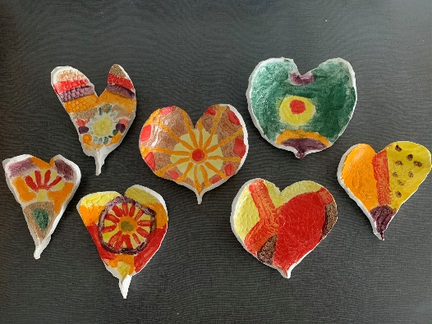
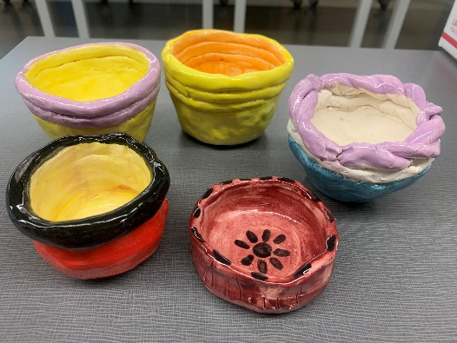
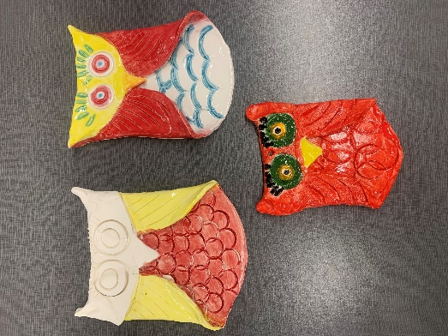
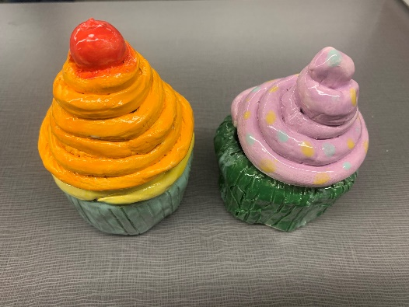
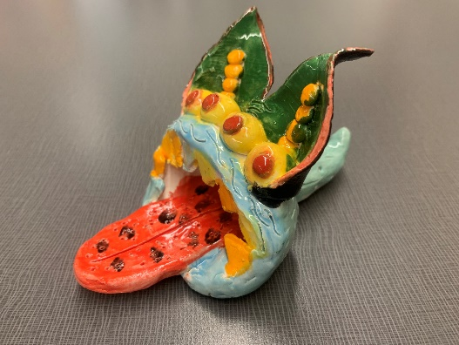
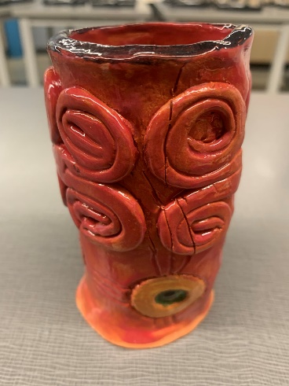
Clay Class Projects
Grade K: Pinch Pots | Grade 1: Heart-shaped Dish | Grade 2: Owls
Grade 3: Cupcakes | Grade 4: Native American Pencil Pots | Grade 5: Monsters

Slide 8
Time Commitment
DSS Lessons
6 DSS lessons, spread throughout the year
1 ½ hours per class (inc. 15 mins either side for setup/clean up))*
(*Note: some lessons may take longer, some may require more than one lesson to complete)
Clay Art
Two clay Art sessions (one to create, one to glaze)
1.5 - 2 hours per class (inc. 30 mins either side for setup/cleanup))
Two Kiln firing sessions after creation and glazing each (you choose your time!)
Please work with your class teachers to determine your schedule.

Slide 9
DSS Lesson Plans & Supplies
DSS Lesson Plans
White folder in STEAM Lab
PDFs online (https://wilderptsa.ptoffice.com/art-docent)
Teachers use DSS step-by-step lesson videos
Materials in the storage room in STEAM Lab
Watercolor paper:
For lessons that require size 18” x 12” watercolor paper, use 15” x 11”
For lessons that require size 12” x 9” watercolor paper, use 11” x 10”
Construction paper:
Some lessons require you to prepare smaller pieces of construction paper
You have access to the 12” cutter in the copy room, 2nd floor

Slide 10
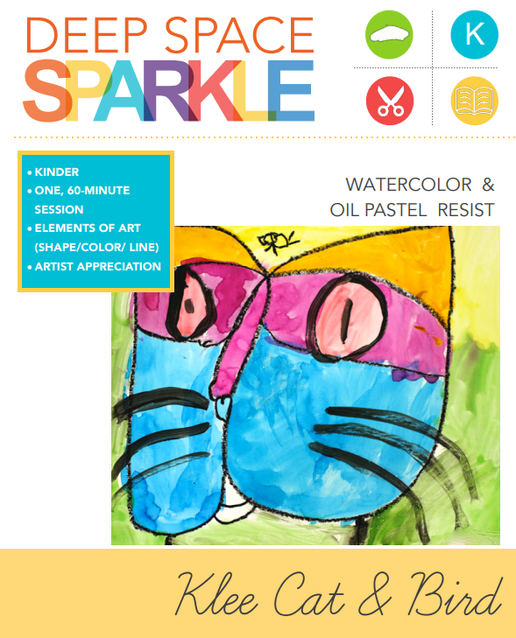
Sample DSS Lesson Plan

Slide 11
Clay Art Lesson Plan & Supplies
Clay Lesson Plans:
Blue folder in STEAM lab supply room
PDFs: Kindergarten Grade 1 Grade 2 Grade 3 Grade 4 Grade 5
Art Docent Handbook
Step-by-step lesson videos: Kindergarten Grade 1 Grade 2 Grade 3 Grade 4 Grade 5
Materials in the storage room (Shelves are marked)

Slide 12
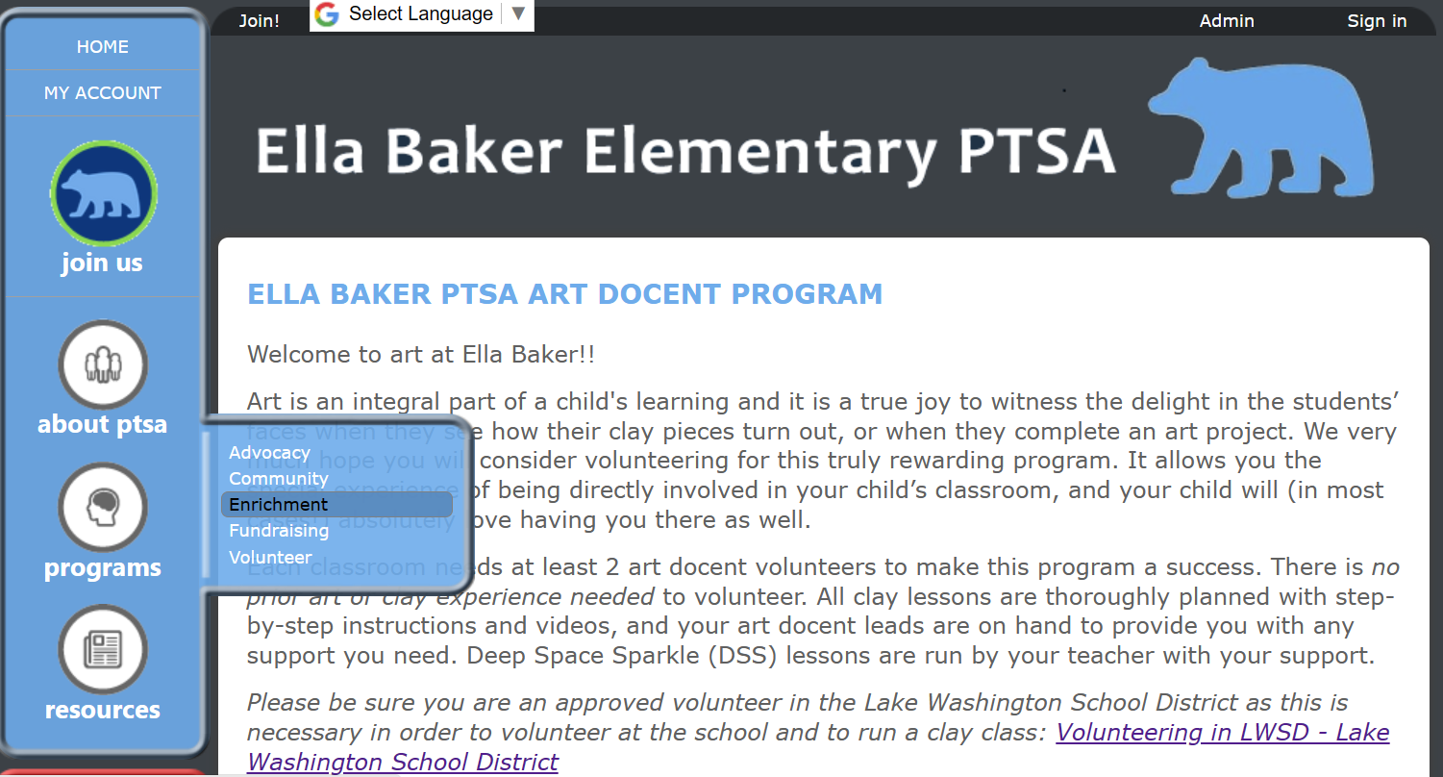
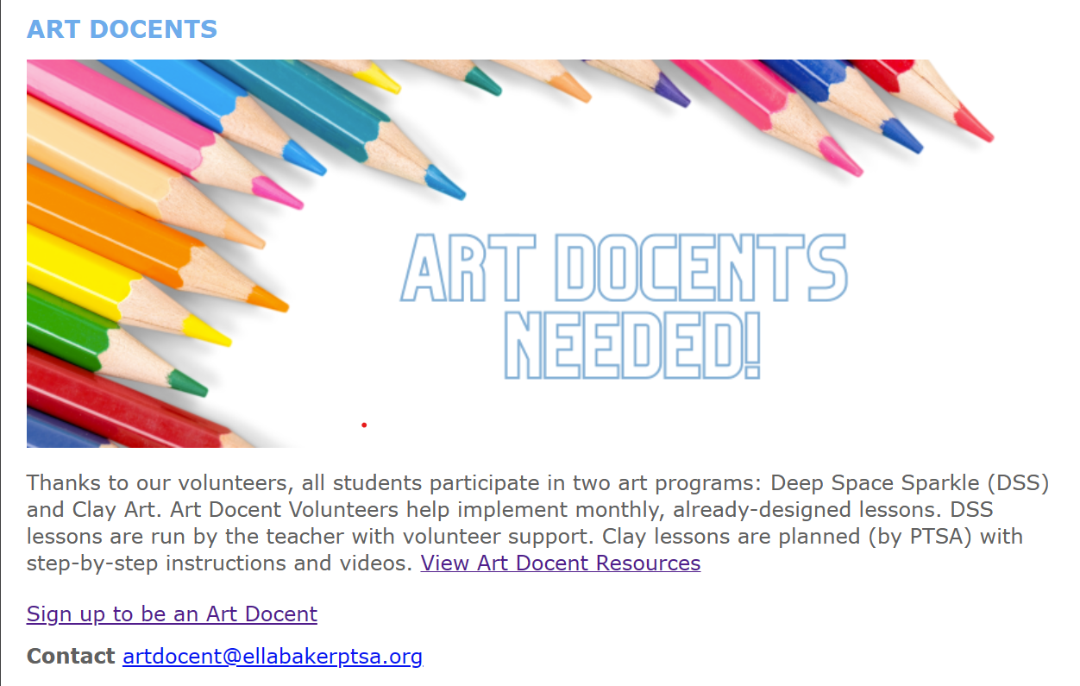
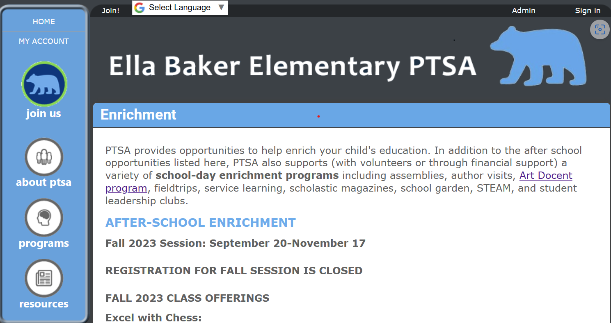
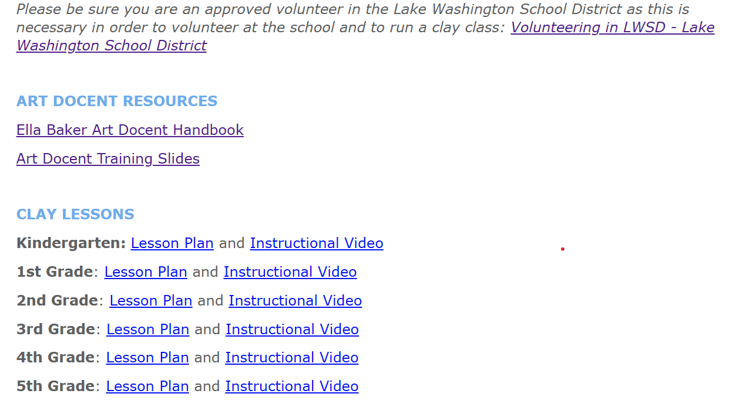
Open Ella Baker PTSA page
Click on programs -> enrichment
Click “Art Docent Program”
Click “View Art Docent Resources”
Scroll down to see lesson plans and videos

Slide 13
Extra Art Lessons (optional)
Help support teacher with changemaker projects or other art projects to support the curriculum or classroom work
Optionally, lead more art classes (depending on your bandwidth and the teacher’s schedule)
See https://www.lwsd.org/get-involved/parent-community-partnerships/art-docent
Supplies for extra art lessons must come from the classroom or we can reach out to the PTSA. Please do not use DSS supplies!!

Slide 14
DSS Action Items!!
Know your peers and identify who will be the main point of contact.
Plan to email your teacher this week:
Introduce yourself & the other art docents in your class
Ask if they would like support for DSS (setup/cleanup/support in class)
Find out if they already have a DSS schedule or need to create one
Ask them to book Steam Lab if they plan lessons here
**Check there are plenty of supplies 2 weeks before your class
Walk through Supply Room
Read Art Docent Handbook

Slide 15
Clay Action Items!!
Attend Clay and Kiln training on Oct 11, 2023 at 9:30 am** This will give you hands-on experience with Clay and Kiln.
Ask Teacher to schedule 2 clay classes one month apart (2 hours per class) on the STEAM lab calendar.
TIP: Avoid scheduling clay classes to start at 9:20am or end at 3:50pm (no time for setup or cleanup)
Plan to do final glaze class BEFORE end of May
Plan for Kiln schedule after clay and glaze classes
Send your teacher a link to the clay lesson video so students can watch it prior to your class
** Subject to Clay delivery

Slide 16
Questions?
Special Credits &Thanks
Jill Willison, Aimee Palacios & Ella Baker PTSA

